Slide 1

SE 3007: INTRODUCTION TO MACHINE LEARNING
AI IMPACT ON JOBS: PREDICTING JOB RISK &
FUTURE SKILLS
presented by:
Ömer Faruk Kaba
Ahmet Sefa Yıldırım
Yusuf Şaban Tosuncuk

Slide 2
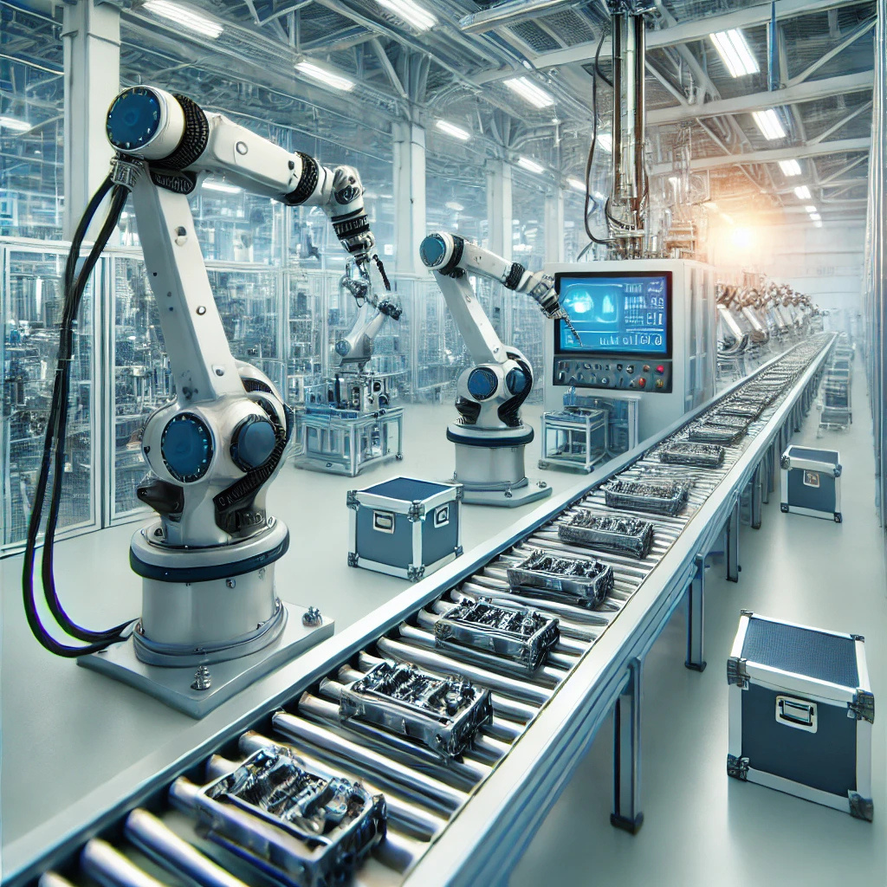
SE 3007: INTRODUCTION TO MACHINE LEARNING
PAGE 02
WHAT THIS STUDY DOES?
  Predicts the automation risk of occupations using machine learning
  Classifies jobs into High / Medium / Low AI vulnerability
  Suggests alternative low-risk jobs based on skills
  Builds a sector-level AI Resilience Index
  Provides a data-driven framework for future workforce decisions
WHY IT MATTERS?
AI will transform millions of jobs, understanding risk today helps prepare for tomorrow.

Slide 3
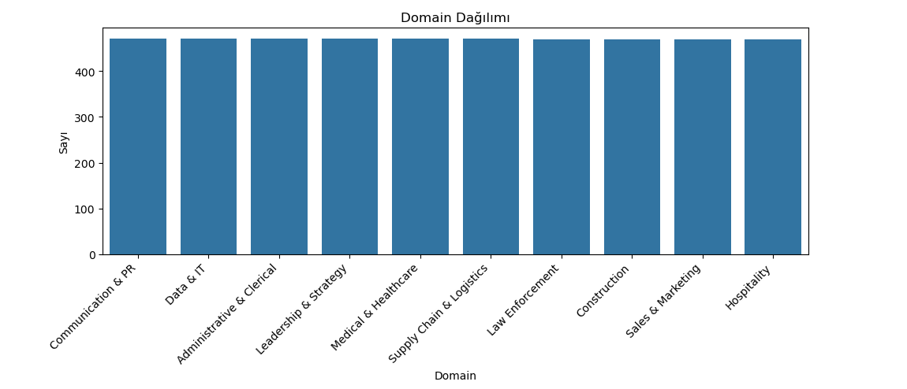
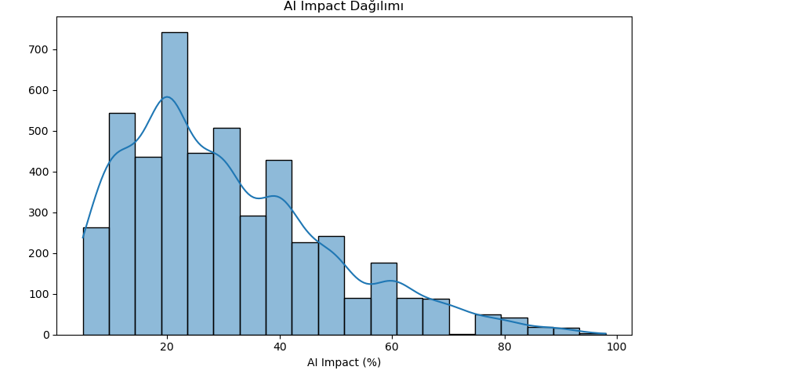
SE 3007: INTRODUCTION TO MACHINE LEARNING
PAGE 03
EXPLORATORY DATA ANALYSIS
DOMAIN DISTRIBUTION
01
The dataset is evenly distributed across all domains. The average AI Impact values are very similar across domains, indicating a balanced and synthetic dataset structure.
AI IMPACT DISTRIBUTION
02
The AI Impact distribution is right-skewed, meaning low and medium risk jobs are more common, while highly automatable jobs are fewer

Slide 4
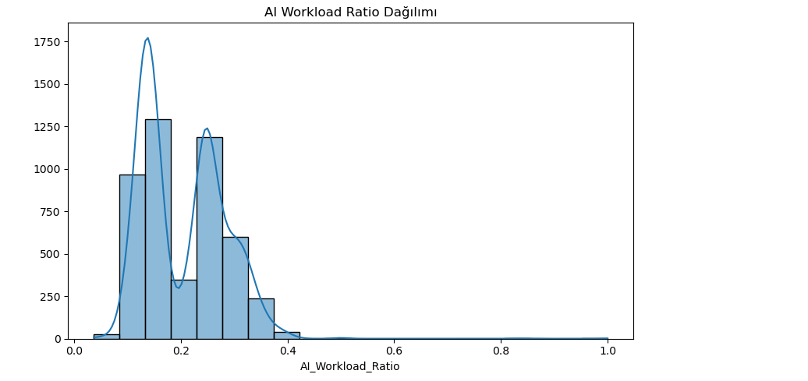
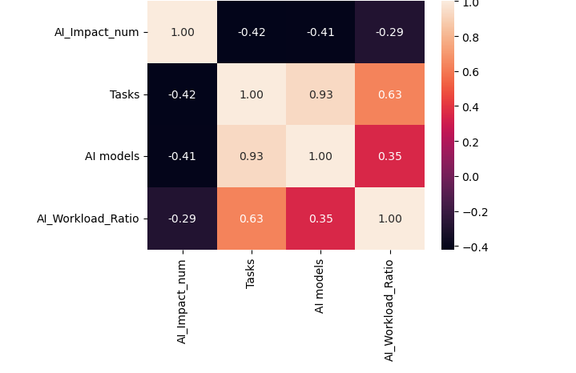
SE 3007: INTRODUCTION TO MACHINE LEARNING
PAGE 04
EXPLORATORY DATA ANALYSIS
AI WORKLOAD RATIO
03
AI Workload Ratio is mostly concentrated between 10%–30%; meaning most jobs contain a moderate amount of automatable tasks.
CORRELATION MATRIX
04
There is a strong positive correlation between Tasks and AI models. AI Impact shows a moderate negative correlation with these variables.

Slide 5
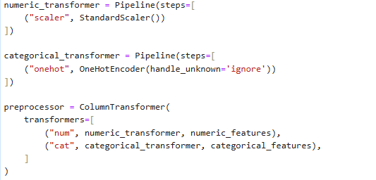
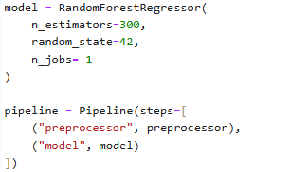
SE 3007: INTRODUCTION TO MACHINE LEARNING
PAGE 05
AI RISK PREDICTION MODEL - REGRESSION
PIPELINE
The preprocessing steps operate through separate pipelines for numeric and categorical features. Numeric data is scaled, while the Domain feature is one-hot encoded and combined through a ColumnTransformer.
MODEL SETUP
All preprocessing steps and the RandomForestRegressor are merged into a single Pipeline, ensuring consistent training and reproducible results.

Slide 6

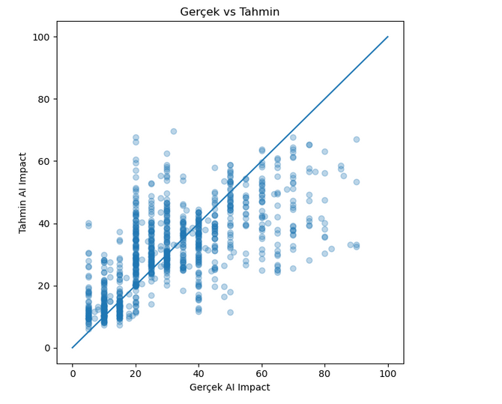
SE 3007: INTRODUCTION TO MACHINE LEARNING
PAGE 06
AI RISK PREDICTION MODEL - REGRESSION
MODEL PERFORMANCE
The model achieves MAE ≈ 9.99 and RMSE ≈ 14.16, indicating moderate prediction error. R² ≈ 0.439 means the model explains about 44% of the variance.
WHY RANDOM FOREST?
MODEL VISUALIZATION
  Captures non-linear relationships
  Robust against noise and outliers
  Works well with mixed data types
  Provides stable and explainable predictions
The scatter plot shows that predictions follow the overall trend. Many points align near the 45° line, indicating strong consistency between predicted and actual AI Impact values.

Slide 7
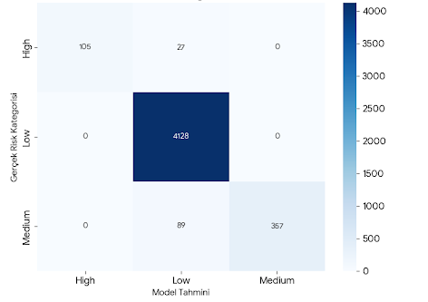
SE 3007: INTRODUCTION TO MACHINE LEARNING
PAGE 07
JOB VULNERABILITY CLASSIFICATION
To classify occupations into Low – Medium – High risk groups based on their AI Impact scores.
STEPS
  Normalized the AI Impact score and converted it into 3 classes.
  Built preprocessing pipeline (Scaler + OneHotEncoder).
  Trained a RandomForestClassifier.
  Evaluated performance using accuracy + confusion matrix.
CONFUSION MATRIX
The model predicts the Low risk class with extremely high accuracy. Although there is minor confusion between High and Medium classes, the overall accuracy (97.54%) is very strong.

Slide 8
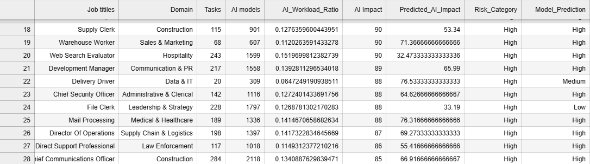
SE 3007: INTRODUCTION TO MACHINE LEARNING
PAGE 08
JOB VULNERABILITY CLASSIFICATION
Model Output

Slide 9
SE 3007: INTRODUCTION TO MACHINE LEARNING
PAGE 09
FUTURE PROOF SKILLS RECOMMENDER SYSTEM
Suggest safer, low-risk job alternatives based on skill similarity.
What Does the Future-Proof Skills Recommender Do?
Goal: For a high-risk job, suggest lower-risk occupations that require similar skills.
INPUT
  User’s job (Job Title)
  Skill scores of that job
  Risk category (High / Medium / Low)
SENTENCE TRANSFORMER
We used the SentenceTransformer (all-MiniLM-L6-v2) model to encode job titles into numerical vectors that preserve semantic meaning. This allows the system to understand that terms like “developer” and “software engineer” are closely related.
SETUP
  Build a skill vector for every job.
  Compute similarity between vectors using cosine similarity.
  Filter jobs with lower AI risk than the original one.
  Return the top 5–10 jobs with the highest similarity as recommendations.

Slide 10

SE 3007: INTRODUCTION TO MACHINE LEARNING
PAGE 10
FUTURE PROOF SKILLS RECOMMENDER SYSTEM
Suggest safer, low-risk job alternatives based on skill similarity.
CODE LOGIC
1- Each job is converted into a numerical vector:
job​→[s1​,s2​,s3​,...]
This vector describes the strengths of that job across different skills.
2- Create a Skill Matrix
We combine all job vectors into a matrix where:
  Rows = jobs
  Columns = skill values
  This forms the search space for similarity.
3- Use Cosine Similarity
We compute similarity between all job vectors using cosine
​
A score close to 1 → very similar skills
A score close to 0 → very different skills
5 - Filter by Lower Risk Jobs
When the user selects a job:
  We check its risk level (High / Medium / Low)
  We filter only the jobs with lower AI risk
  (e.g., High → Medium & Low)
This makes the recommendations both safe and relevant.
6 - Rank by Similarity
Among the lower-risk jobs,
we sort them by similarity score in descending order.
Top 5 or Top 10 most similar jobs are selected.
7 - Return Recommendations
The system outputs a list of careers that have:
✔ similar skills
✔ lower AI risk

Slide 11
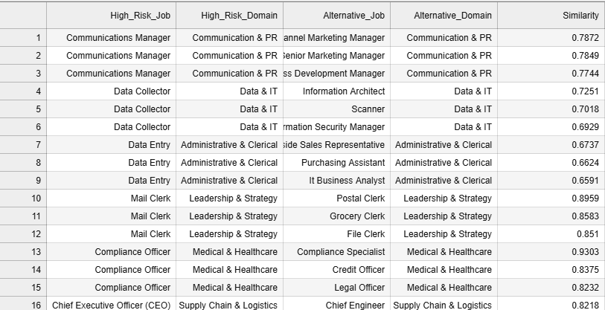

SE 3007: INTRODUCTION TO MACHINE LEARNING
PAGE 11
FUTURE PROOF SKILLS RECOMMENDER SYSTEM
Model Output:
SIMILARITY SCORE :
Our recommendation engine uses a hybrid similarity model that combines Sentence Transformer semantic embeddings with cosine similarity on domain and numeric features. The final similarity score is a weighted blend of these three components.

Slide 12
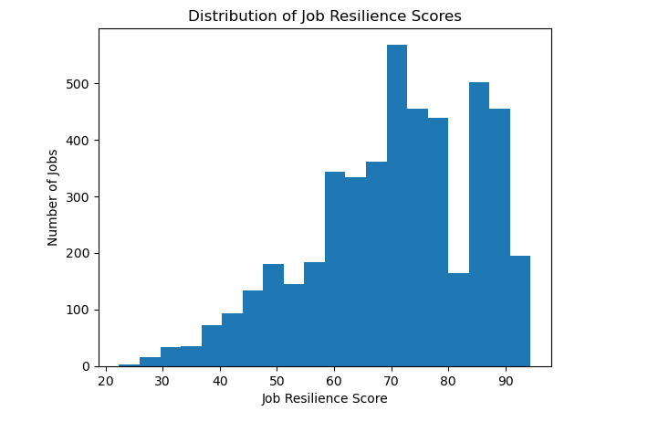
SE 3007: INTRODUCTION TO MACHINE LEARNING
PAGE 12
SECTOR AI RESILIENCE INDEX
Measuring how resilient each sector is against AI-driven automation.
Resilience Index:
0.35 × (1 – AIImpactNorm)
+ 0.25 × (1 – AIWorkloadNorm)
+ 0.20 × TasksNorm
+ 0.20 × DomainComplexityNorm
We created an AI Resilience Index to measure how resistant each sector is to AI-driven automation. The index is calculated from multiple factors such as average AI impact, task complexity, model usage intensity, and AI workload ratio.
To compute the Sector AI Resilience Index, we aggregated each sector’s:
  Average AI Impact
  Average Tasks
  Average AI models
  Average AI_Workload_Ratio
All metrics were normalized, inverted where necessary, and combined into a single resilience score.

Slide 13
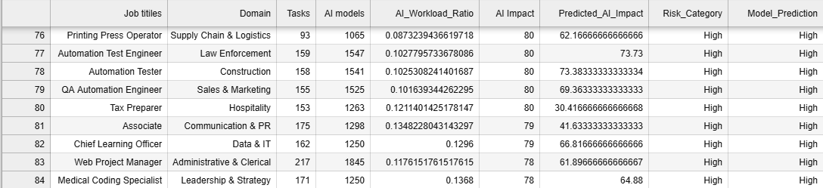
SE 3007: INTRODUCTION TO MACHINE LEARNING
PAGE 13
SECTOR AI RESILIENCE INDEX
Measuring how resilient each sector is against AI-driven automation.
Model Output:

Slide 14
SE 3007: INTRODUCTION TO MACHINE LEARNING
PAGE 14
LIMITATIONS
While the models provide meaningful insights, several limitations should be considered:
  Synthetic Dataset: The dataset is artificially generated, meaning real-world labour dynamics, economic factors, and nuanced job definitions may not be fully captured.
  Feature Availability: The skill columns and workload indicators are limited.
  Model Interpretability: RandomForest provides strong predictive performance but limited interpretability compared to linear or SHAP-based approaches.
  Semantic Dependence: SentenceTransformer embeddings rely solely on job titles, not full job descriptions, which may reduce semantic accuracy.
  Static Analysis: The models assume static AI risk; real-world risk changes over time due to technology adoption and economic shifts.
  Domain Encoding Simplicity: One-hot encoding treats domains as independent categories and does not capture relationships between similar sectors.
These limitations highlight the need for more robust, real-world data and more advanced modelling techniques in future work.

Slide 15
SE 3007: INTRODUCTION TO MACHINE LEARNING
PAGE 15
CONCLUSION
In this project, we explored how machine learning can be used to understand and forecast the impact of AI-driven automation on jobs and sectors.
We developed four interconnected models:
AI Risk Prediction Model estimated automation risk using numerical and categorical features.
Job Vulnerability Classification grouped occupations into Low, Medium, and High risk.
Future-Proof Skills Recommender System suggested safer alternative careers using a hybrid similarity model combining semantic (SentenceTransformer) and skill-based measures.
Sector AI Resilience Index quantified how resilient each sector is by aggregating job-level risk and workload indicators.
Overall, our results show that machine learning can effectively capture patterns related to task complexity, domain structure, and skill similarity, enabling data-driven insights for workforce planning, career guidance, and policy decision-making.

